Slide 1
Generating noisy speech data from clean data in the frequency domain using Deep Learning Methods
Week – 20
Name: Shashank Shirol
University: Manipal Institute of Technology
Duration of the presentation: ~10 mins.

Slide 2
Tasks to be completed:
Train CUT with the rest of the channels of RATS data:
Under this, we train CUT with the remaining channels – B, C, E, F, G, H of the RATS data.
Write custom scripts to facilitate swift movement of files – creating consistent dataset across all channels for better comparison.
Modify LSD_cal.py to compute LSD scores for the generated files by locating corresponding GT files in the large dataset.
Train CUT with Digital Noise:
Under this, we subject CUT to the same experiments we did with SinGAN.
We test: Salt and Pepper noise, Speckle Noise, and Poisson Noise (No distinguishable difference in spectrograms)
Write custom module to facilitate adding these noises internally during dataset initialization.

Slide 3
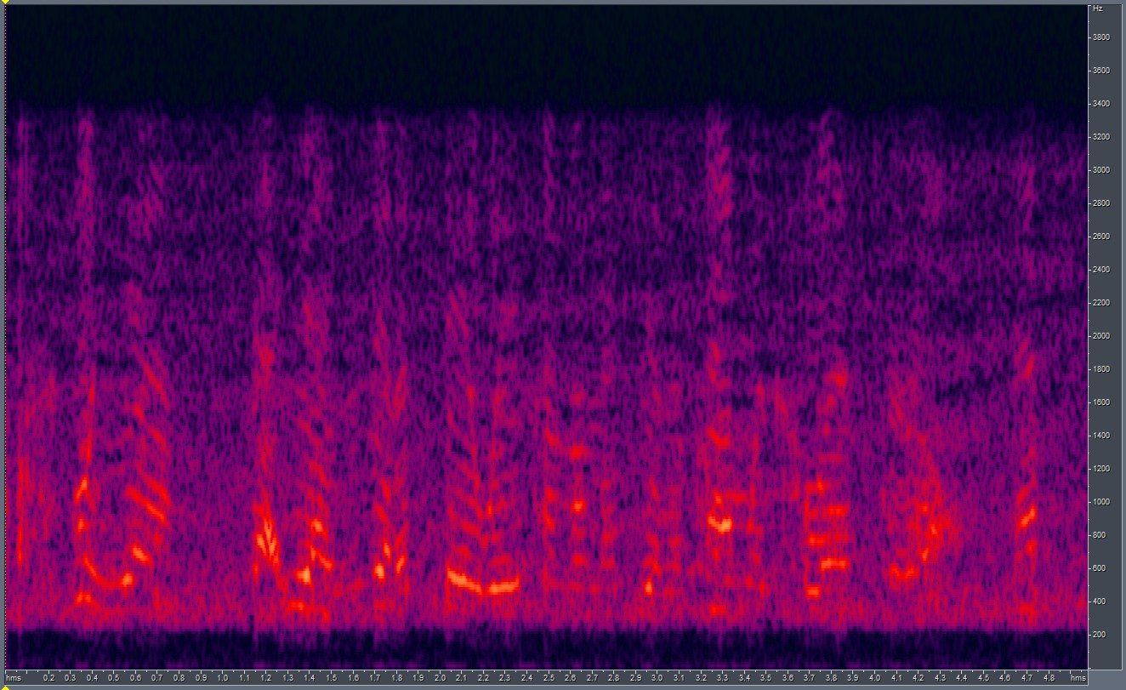
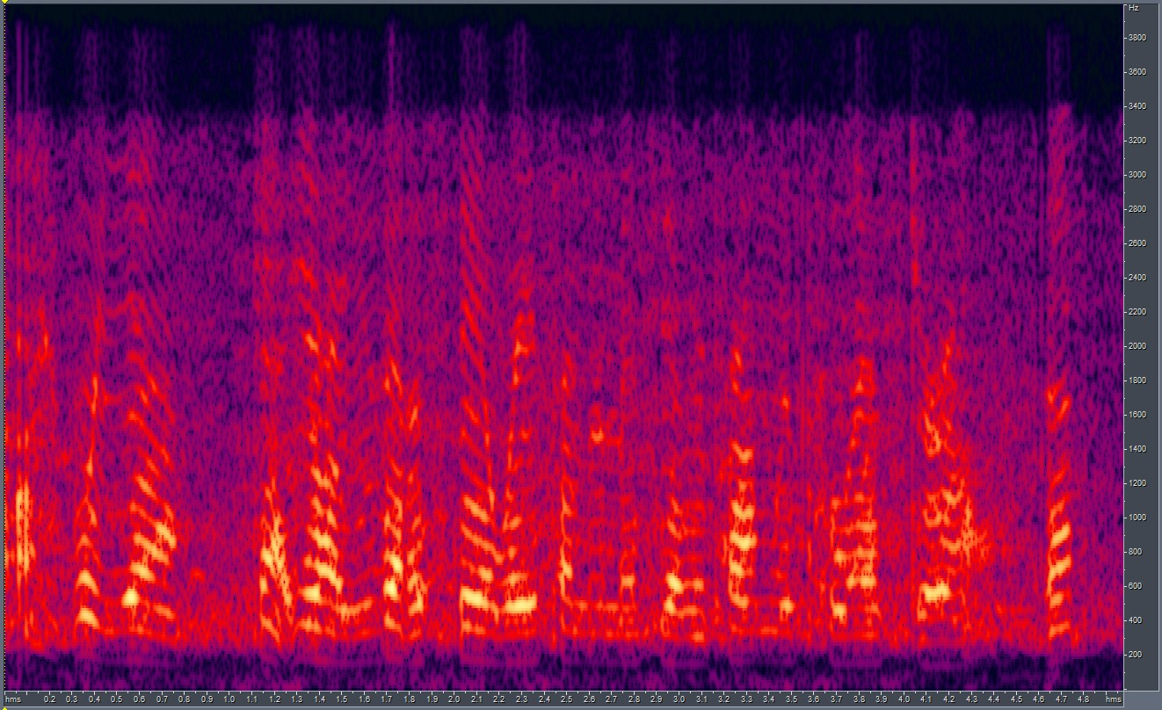

Training CUT with other Channels: Channel B
Avg. LSD = 6.41 Min. LSD = 5.03
Results:
GT
LSD: 5.03
CUT O/P

Slide 4
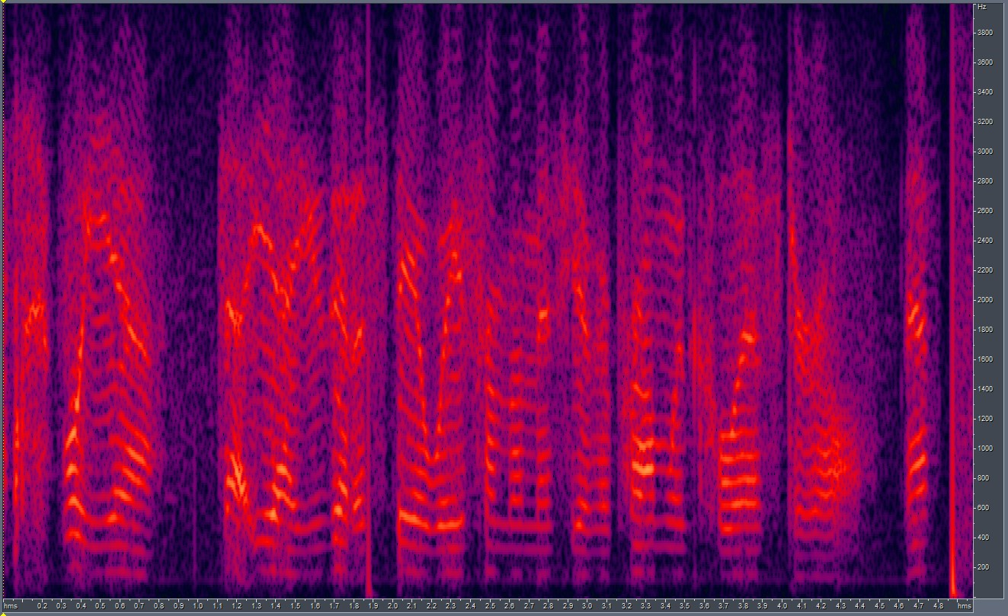
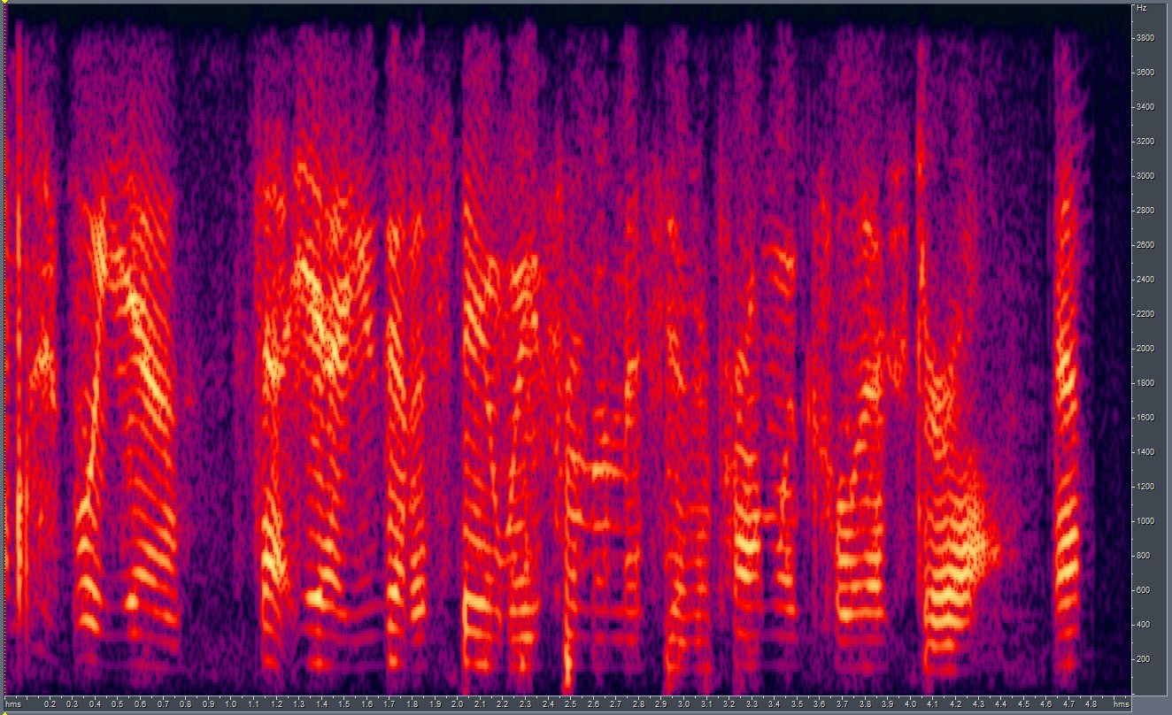
Training CUT with other Channels: Channel C
Avg. LSD = 9.15 Min. LSD = 6.19
Results:
GT
LSD: 6.19
CUT O/P

Slide 5
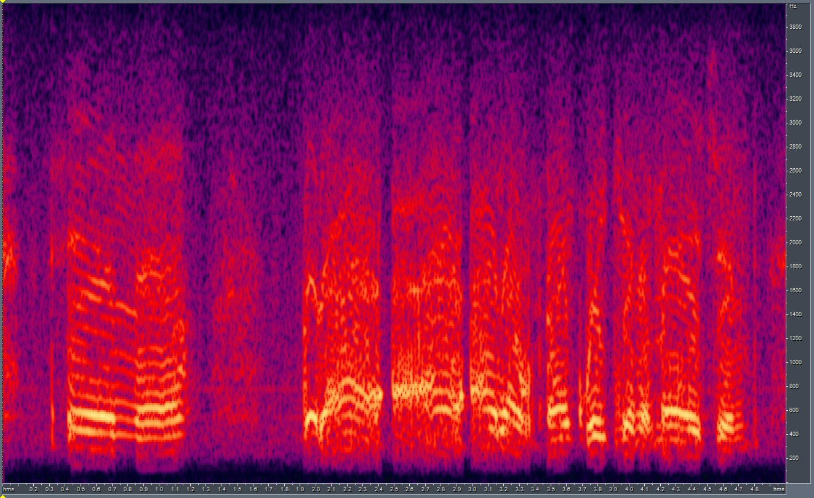
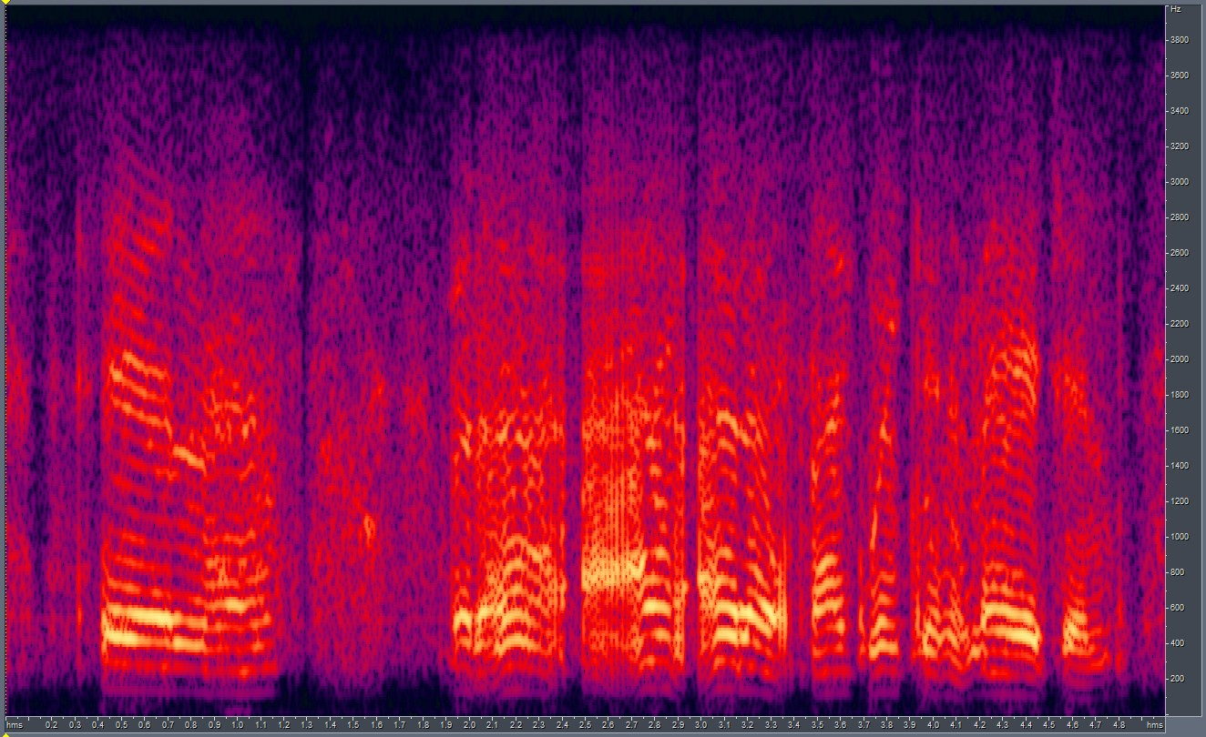
Training CUT with other Channels: Channel E
Avg. LSD = 7.97 Min. LSD = 6.59
Results:
GT
LSD: 6.59
CUT O/P

Slide 6
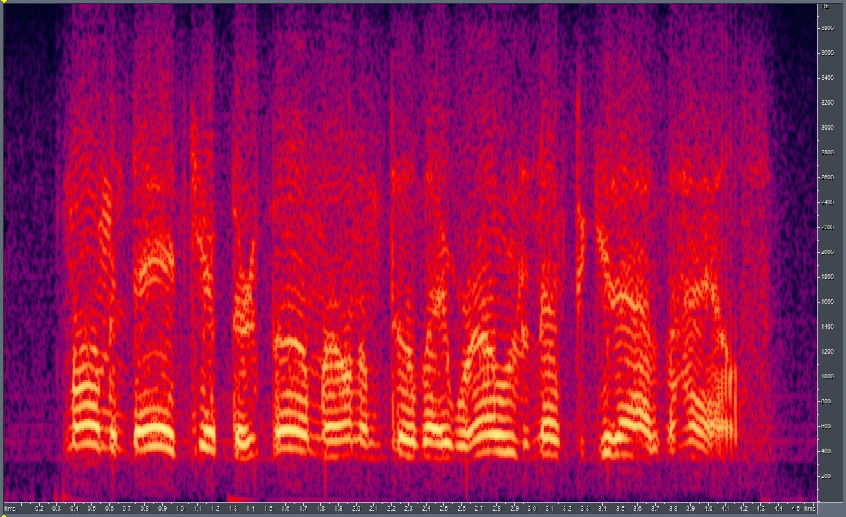
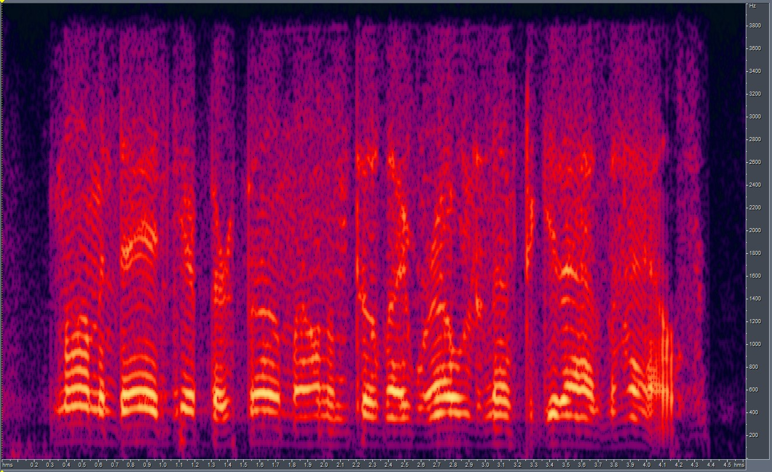
Training CUT with other Channels: Channel F
Avg. LSD = 9.46 Min. LSD = 6.90
Results:
GT
LSD: 6.90
CUT O/P

Slide 7
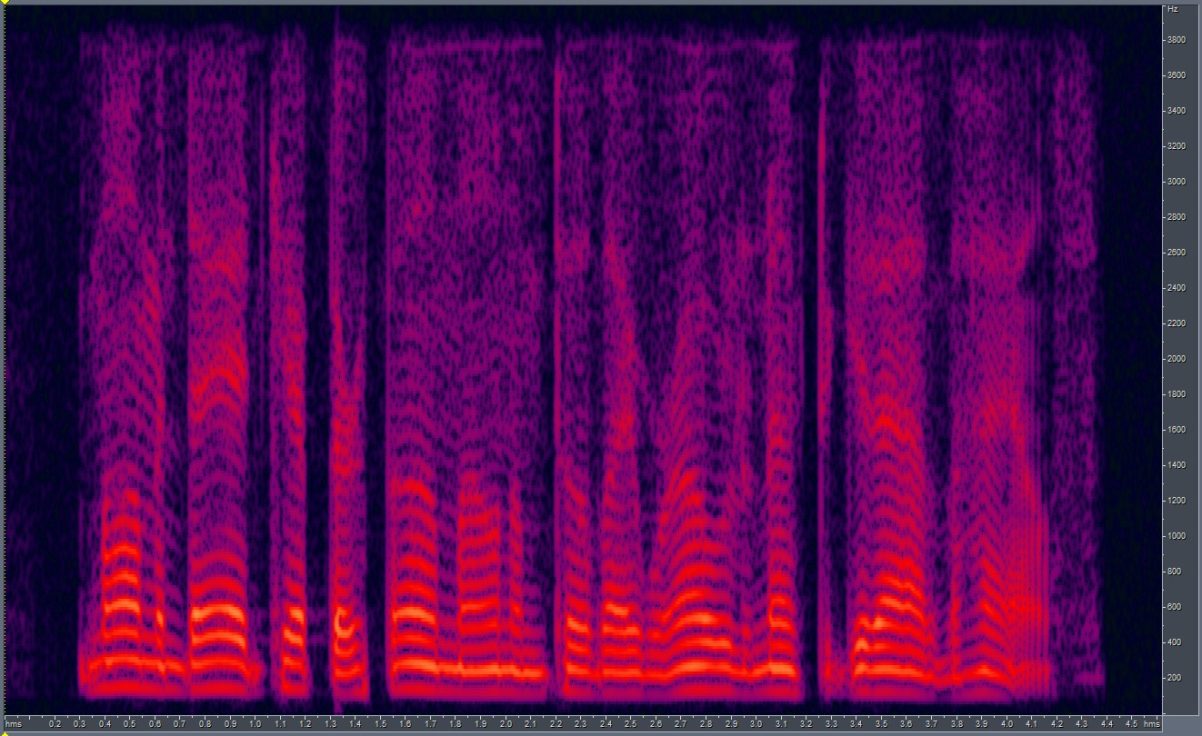
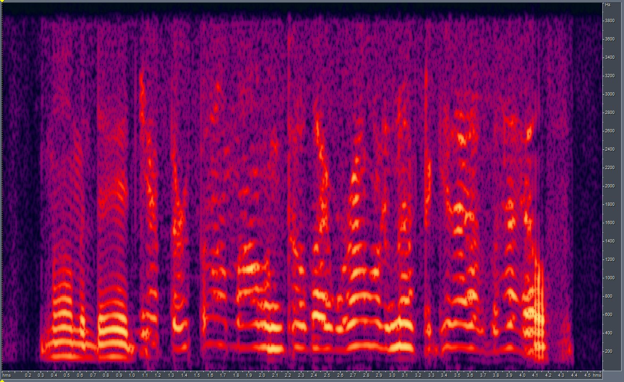
Training CUT with other Channels: Channel G
Avg. LSD = 7.98 Min. LSD = 5.39 (Low Confidence)
Results:
GT
LSD: 5.39
CUT O/P

Slide 8
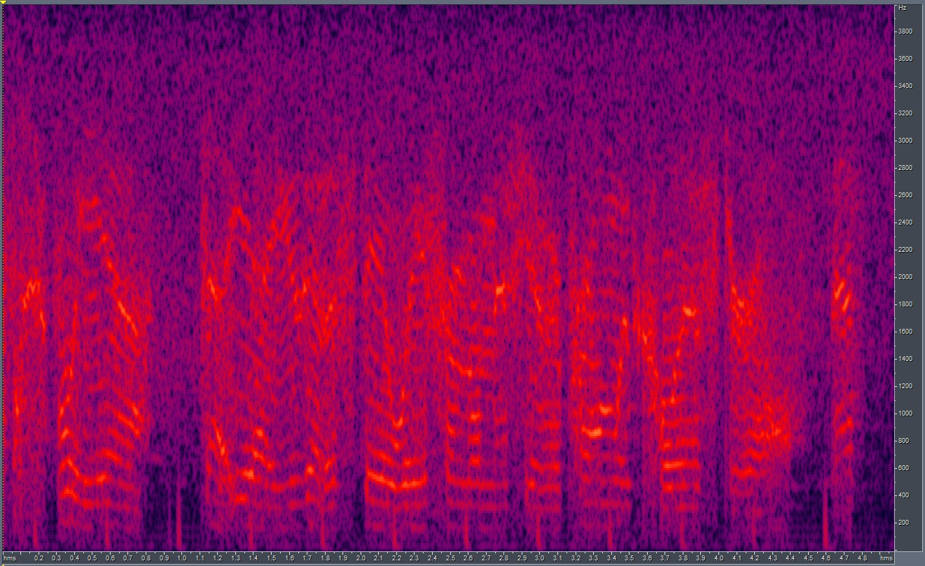
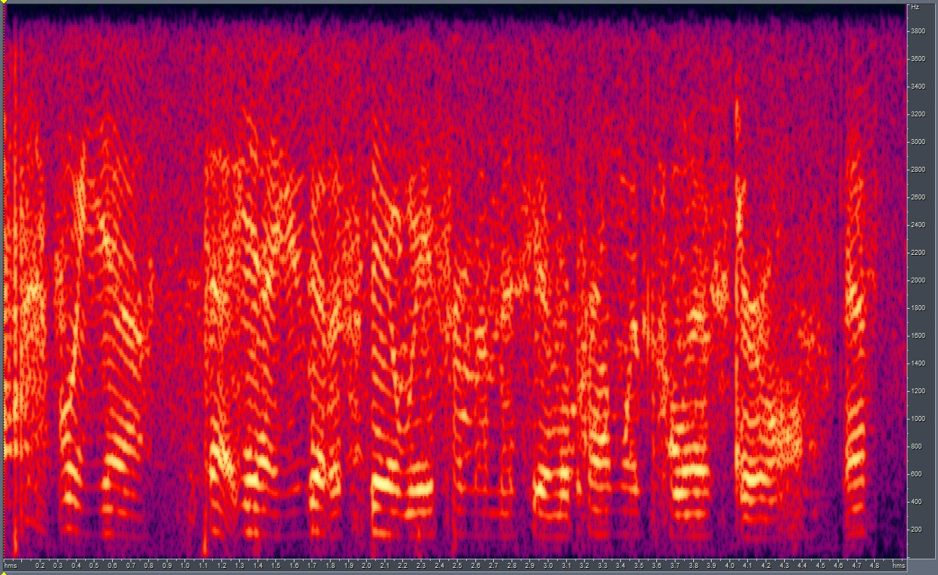
Training CUT with other Channels: Channel H
Avg. LSD = 8.95 Min. LSD = 7.24
Results:
GT
LSD: 7.24
CUT O/P

Slide 9
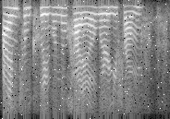
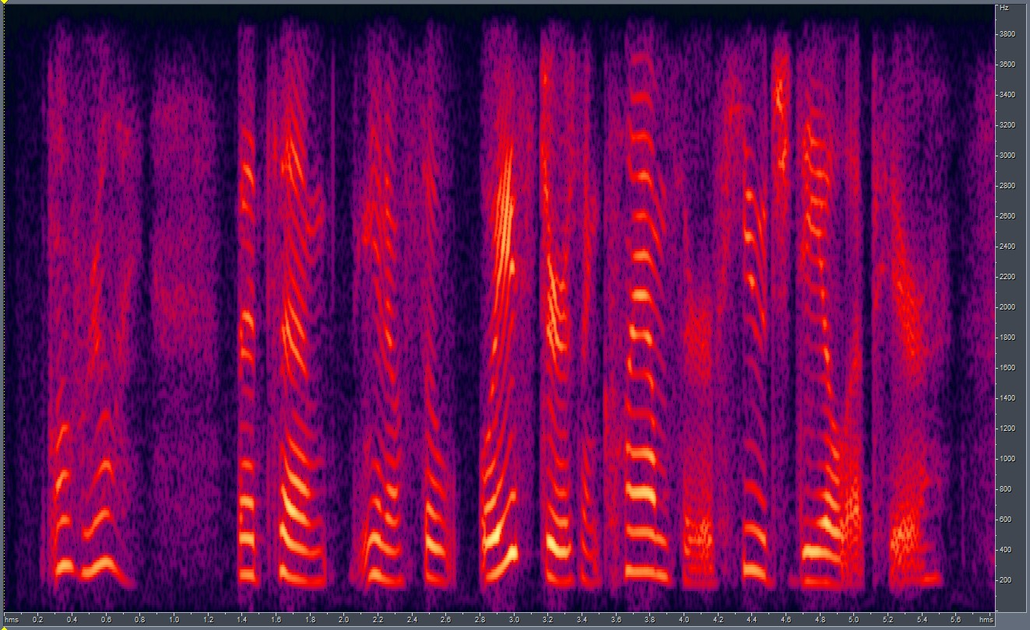
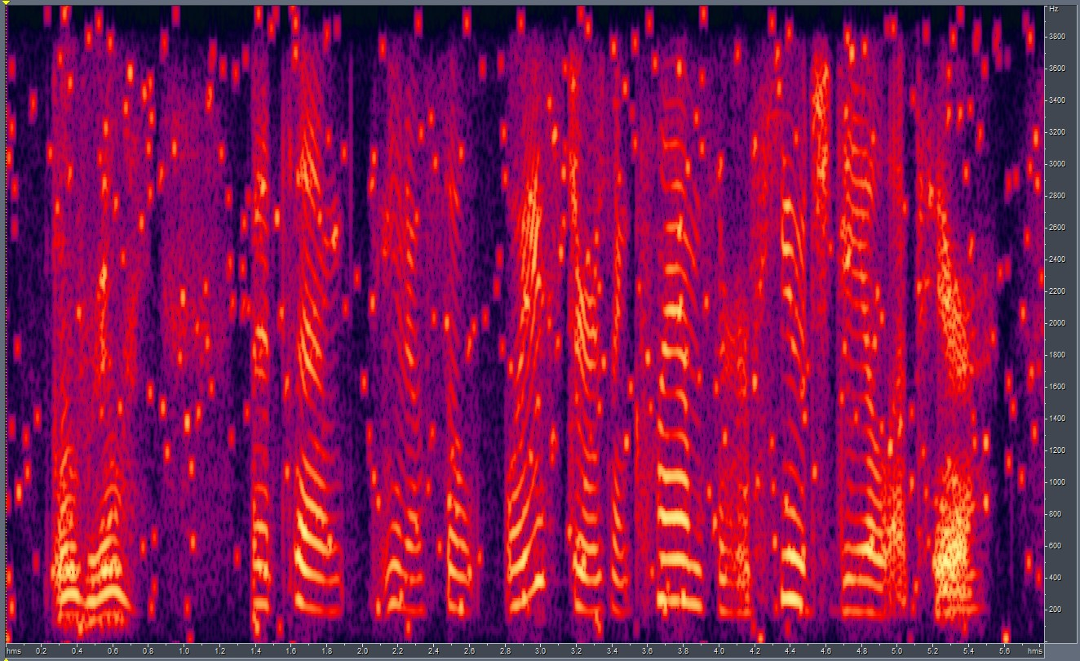
Training CUT with Digital Noise: Salt and Pepper
Salt-and-pepper noise is a form of noise sometimes seen on images. It presents itself as sparsely occurring white and black pixels.
Setup:
Domain A – Clean Audio samples
Domain B – Clean Audio samples + SnP noise added to the spectrograms
Content – Different.
Results:
Input File
CUT output

Slide 10
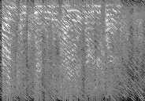
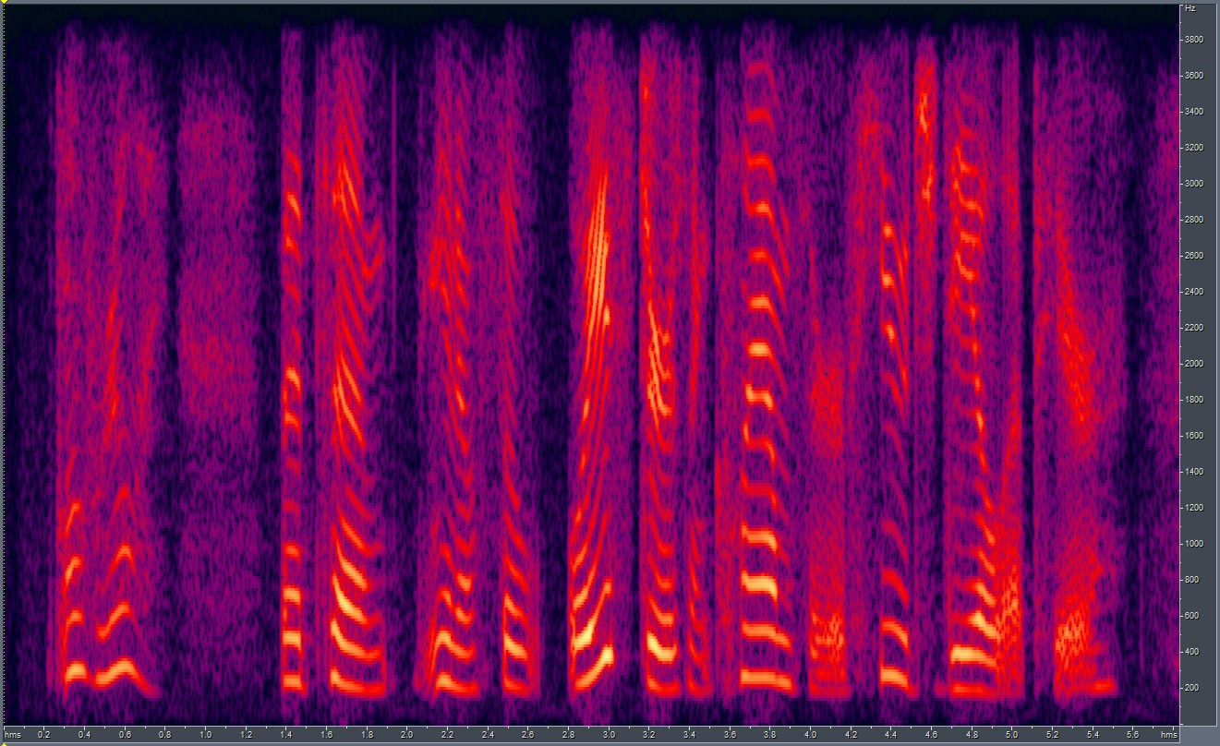
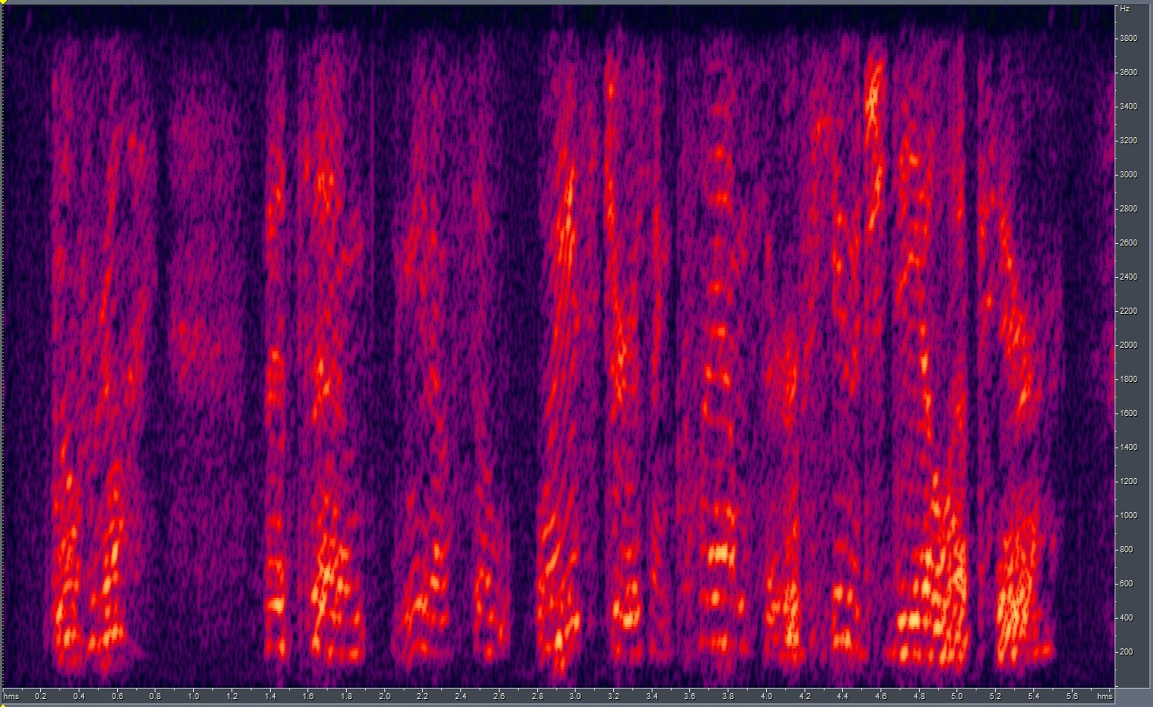
Training CUT with Digital Noise: Speckle
Speckle is a granular noise that inherently exists in an image and degrades its quality. Speckle noise can be generated by multiplying random pixel values with different pixels of an image.
Setup:
Domain A – Clean Audio samples
Domain B – Clean Audio samples + Speckle noise added to the spectrograms
Content – Different.
Results:
Input File
CUT Output

Slide 11
End.

